Slide 1
Better and Interpretable Deep Learning by Paying Attention
RORY WAITE

Slide 2
The Problem
trump locks down delaware gop delegates .
#trump2016 #maga
Trump or Clinton?
A binary classification problem
We will use a vector space model (word embeddings)
Summed word vectors are fed into a classifier

Slide 3









Bag of Words
Sum of vectors
+
$${\vec{w}}_{1}$$
$${\vec{w}}_{2}$$
$${\vec{w}}_{3}$$
$${\vec{w}}_{4}$$
$${\vec{w}}_{5}$$
$${\vec{w}}_{6}$$
$${\vec{w}}_{7}$$
$${\vec{w}}_{8}$$
$${\vec{w}}_{9}$$
trump locks down delaware gop delegates . #trump2016 #maga

Slide 4
Bag of Words with Attention
Weighted sum of vectors
+
⍺₁
⍺₂
⍺₃
⍺₄
⍺₅
⍺₆
⍺₇
⍺₈
⍺₉
$${\vec{w}}_{1}$$
$${\vec{w}}_{2}$$
$${\vec{w}}_{3}$$
$${\vec{w}}_{4}$$
$${\vec{w}}_{5}$$
$${\vec{w}}_{6}$$
$${\vec{w}}_{7}$$
$${\vec{w}}_{8}$$
$${\vec{w}}_{9}$$
trump locks down delaware gop delegates . #trump2016 #maga

Slide 5
LSTM with Attention
Weighted sum of vectors with Recurrence
+
⍺₁
⍺₂
⍺₃
⍺₄
⍺₅
⍺₆
⍺₇
⍺₈
⍺₉
$${\vec{w}}_{1}$$
$${\vec{w}}_{2}$$
$${\vec{w}}_{3}$$
$${\vec{w}}_{4}$$
$${\vec{w}}_{5}$$
$${\vec{w}}_{6}$$
$${\vec{w}}_{7}$$
$${\vec{w}}_{8}$$
$${\vec{w}}_{9}$$
trump locks down delaware gop delegates . #trump2016 #maga

Slide 6

The Attention Mechanism
How do learn the weights?
For the ith word:
$$α_{i}=a({\vec{w}}_{i})$$
Where the function a(∙) is modelled with a feed-forward neural network

Slide 7
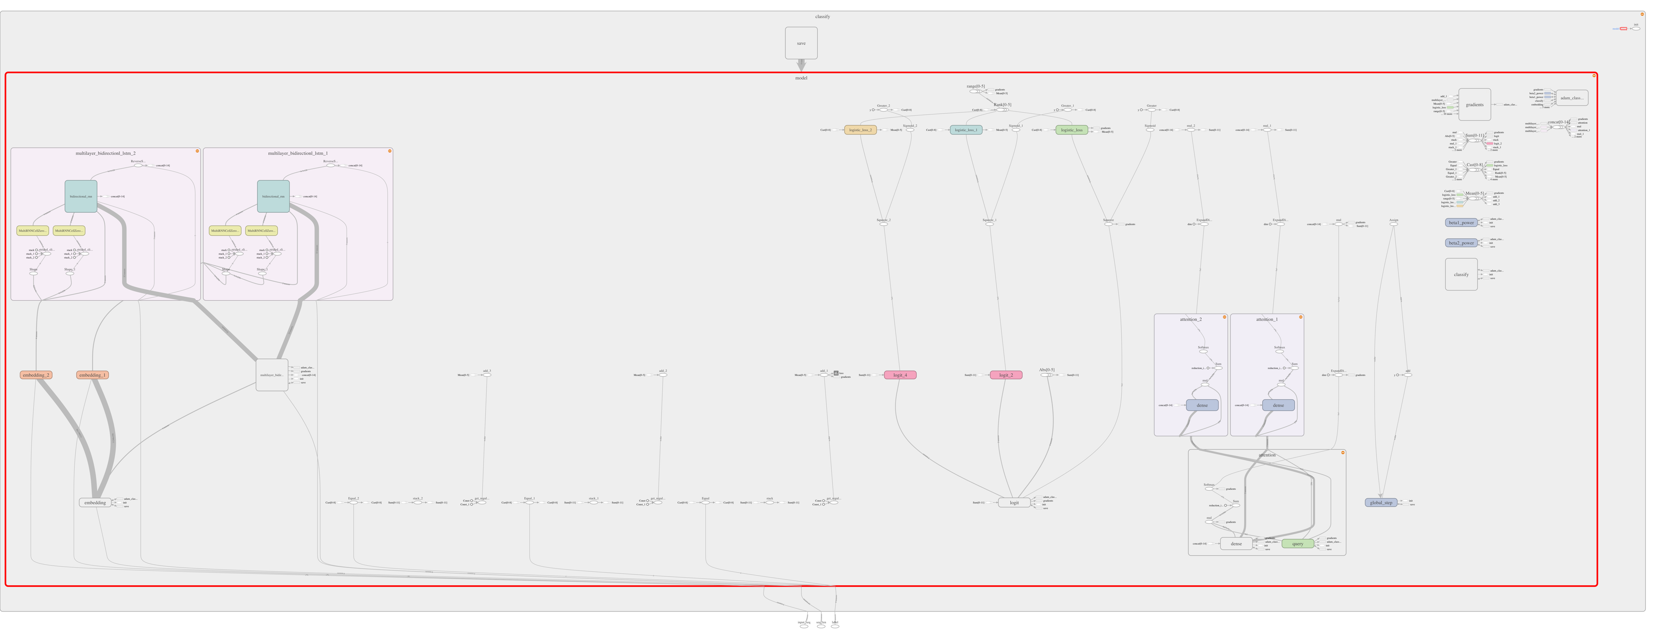
LSTM with Attention Graph

Slide 8
Results
System | # Units | Accuracy | σ
Bag of words | 2 | 96.03 | 0.04
LSTM with attention | 256 | 96.36 | 0.08
Bag of words with attention | 2 | 97.01 | 0.11
An almost 25% decrease in error!

Slide 9
Interpretable Results

Slide 10

Alignment
Attention can be queried with respect to a second vector
$$α_{i,j}=a({\vec{w}}_{i}, {\vec{w}}_{j})$$
Attention will then learn alignments between two units:
A French and an English word in translation
A pixel and an English word in image caption generation
A concept and an English word in language generation
Two points in a time series

Slide 11
Conclusion
Attention is easy
Attention improves models
Attention opens up the black box
Attention is flexible

